Slide 1

UNIVERSITY INSTITUTE OF ENGINEERING
DEPARTMENT OF AIT - CSE
Bachelor of Engineering (CSE)
Advanced Programming (20CST-337)
By: Rahul Rathore(E12904)
Lecture -1
Amortized Analysis, Randomized Algorithms
DISCOVER . LEARN . EMPOWER

Slide 2
Chapter | Course Objectives
1. | This subject aims to focuses on Advanced concept of C++ and advanced data structure to students. It focuses on advanced level analysis of algorithm and computational mathematics.
Chapter | Course Outcomes
1. | Explain the data structure and OOPS concepts using C++. Apply the shortest path and minimum spanning algorithms in computer networks. Examine the complexity of searching and sorting algorithms, and optimization through arrays, linked structures, stacks, queues, trees, and graphs. Decide and implement an appropriate graph algorithm and hashing function in computer networks for data security. Construct security encryption and decryption algorithms using computational mathematics and graph algorithm.

Slide 3
Amortized Analysis
Not just consider one operation, but a sequence of operations on a given data structure.
Average cost over a sequence of operations.
Probabilistic analysis:
Average case running time: average over all possible inputs for one algorithm (operation).
If using probability, called expected running time.
Amortized analysis:
No involvement of probability
Average performance on a sequence of operations, even some operation is expensive.
Guarantee average performance of each operation among the sequence in worst case.

Slide 4
Three Methods of Amortized Analysis
Aggregate analysis:
Total cost of n operations/n,
Accounting method:
Assign each type of operation an (different) amortized cost
overcharge some operations,
store the overcharge as credit on specific objects,
then use the credit for compensation for some later operations.
Potential method:
Same as accounting method
But store the credit as “potential energy” and as a whole.

Slide 5
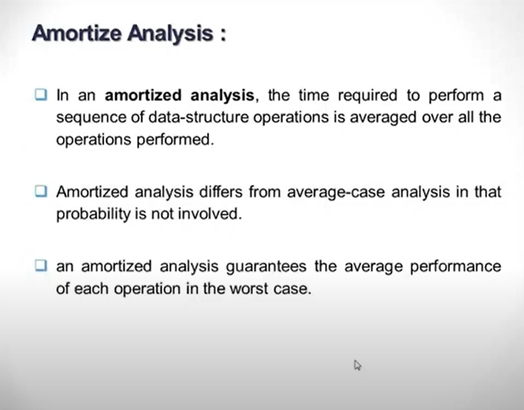

Slide 6
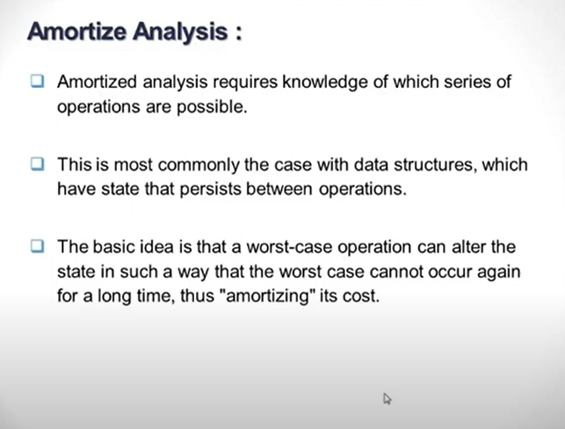

Slide 7
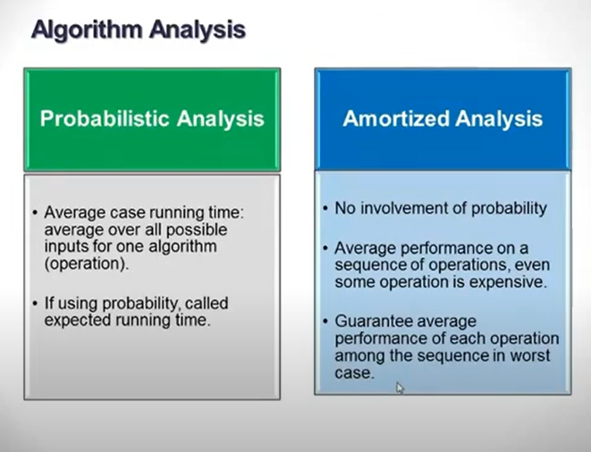

Slide 8
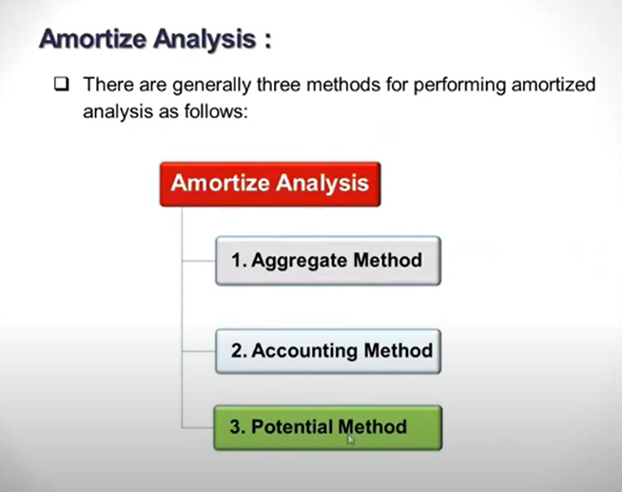

Slide 9
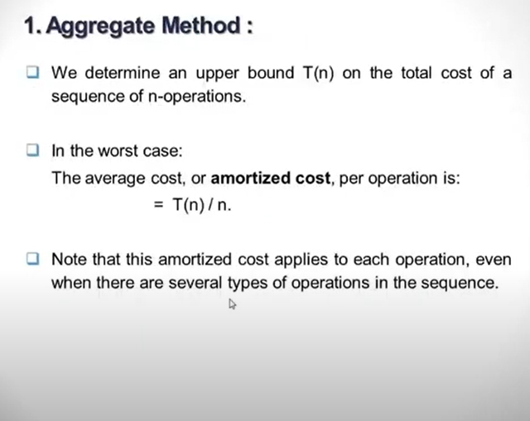

Slide 10
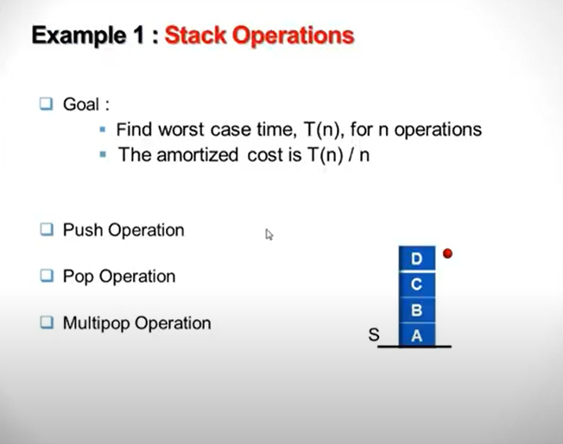

Slide 11
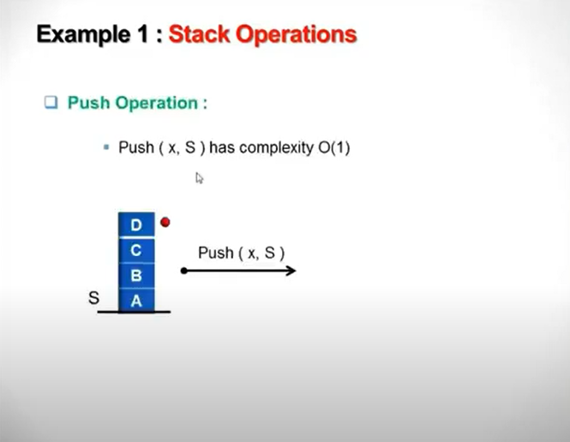

Slide 12
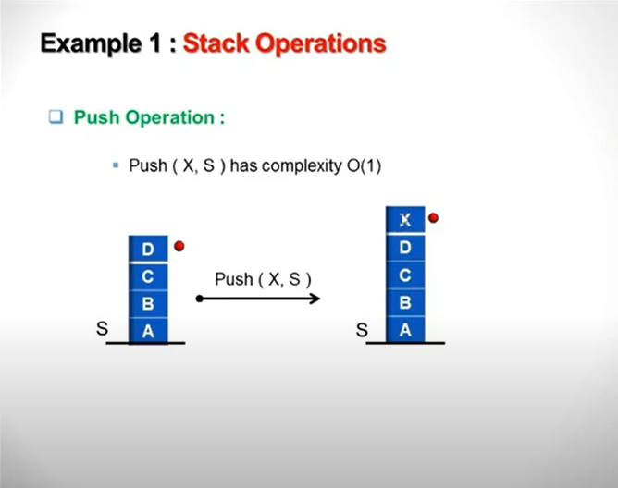

Slide 13
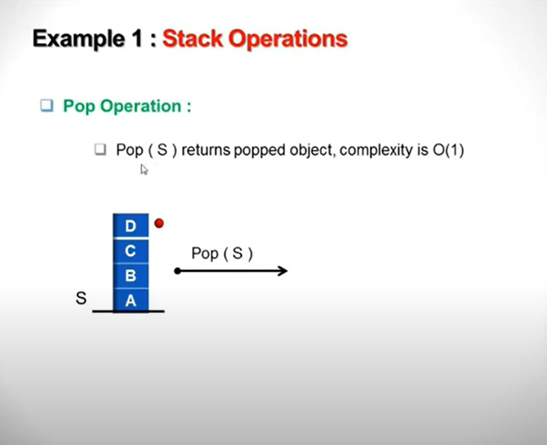

Slide 14
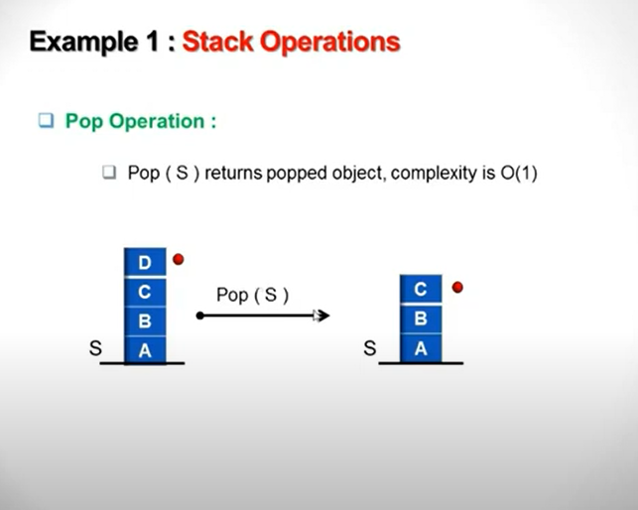

Slide 15
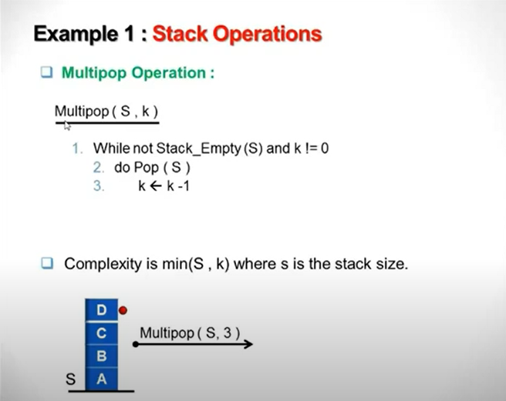

Slide 16
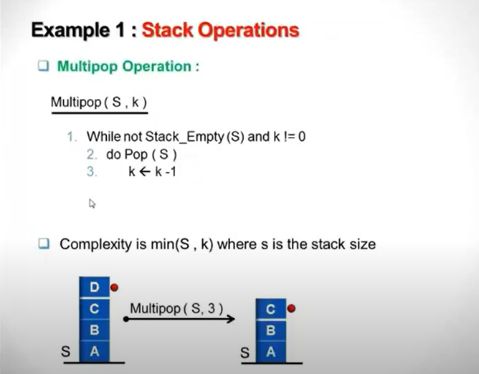

Slide 17
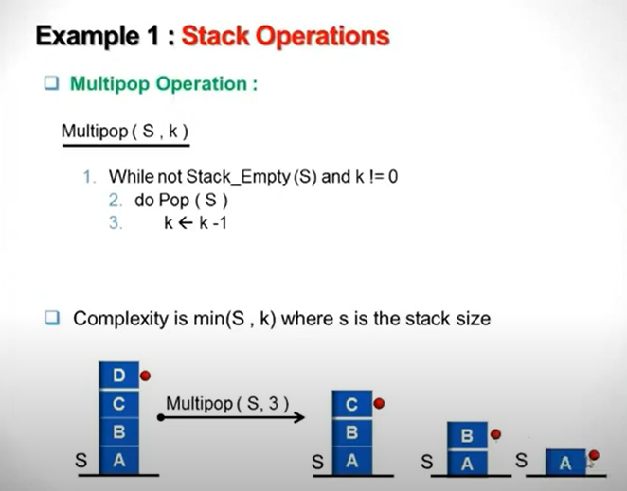

Slide 18
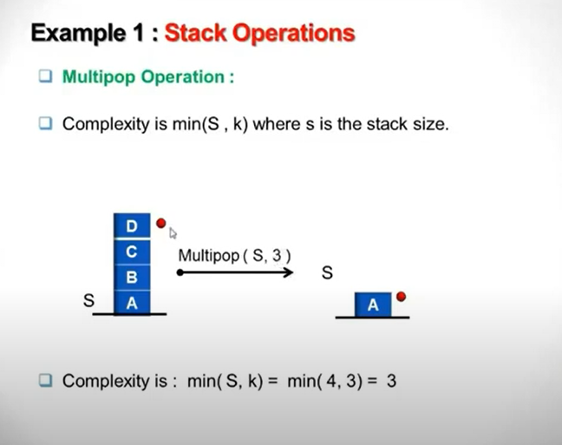

Slide 19
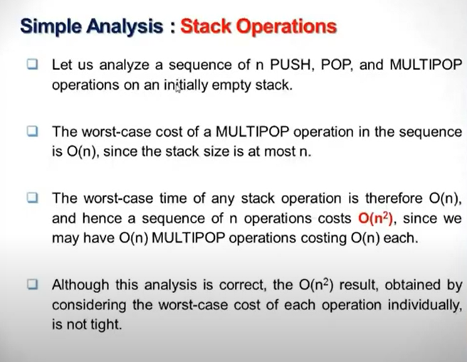

Slide 20
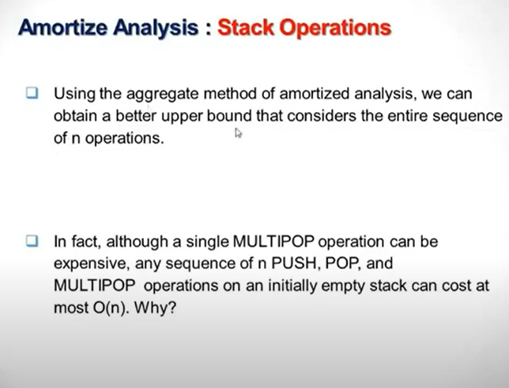

Slide 21
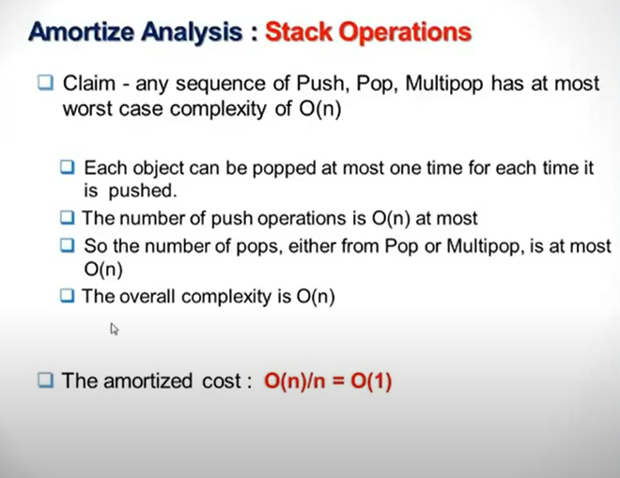

Slide 22
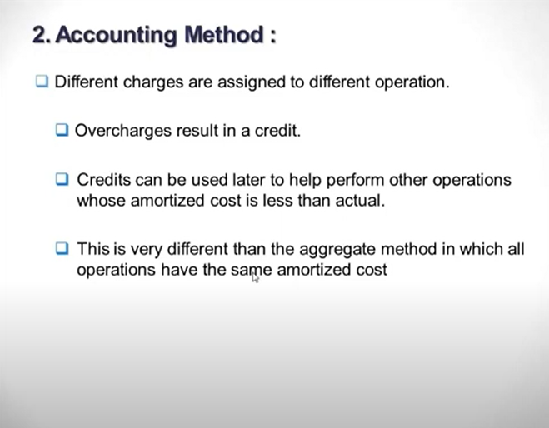

Slide 23
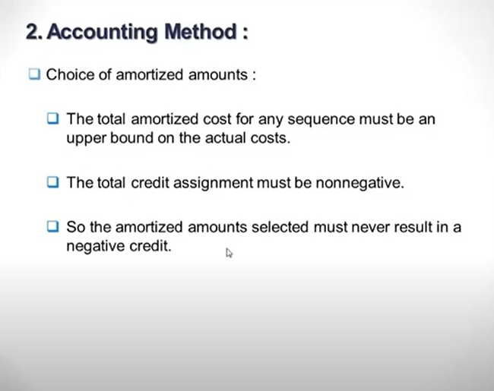

Slide 24
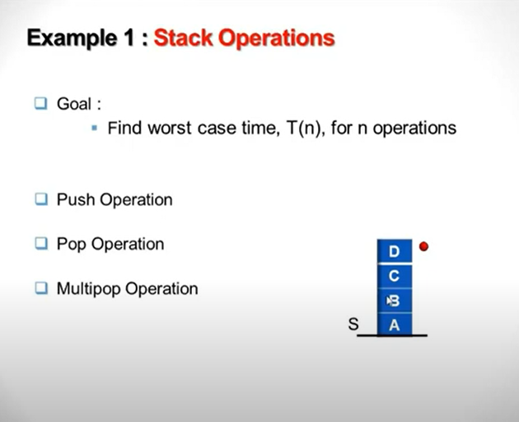

Slide 25
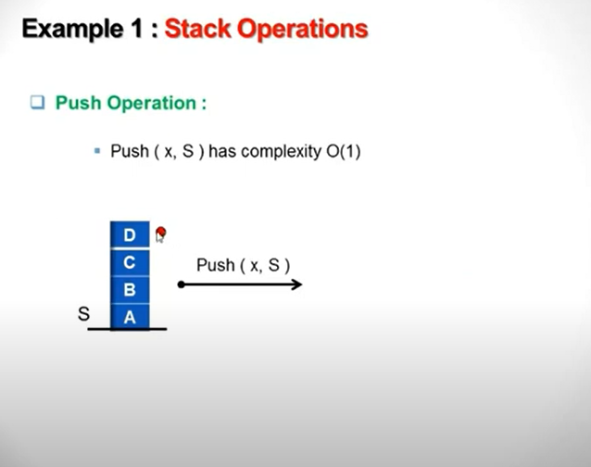

Slide 26
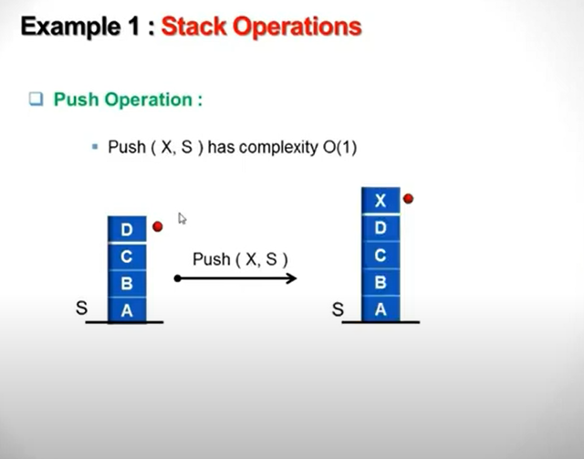

Slide 27
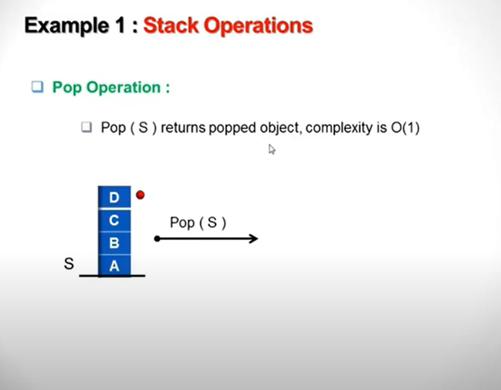

Slide 28
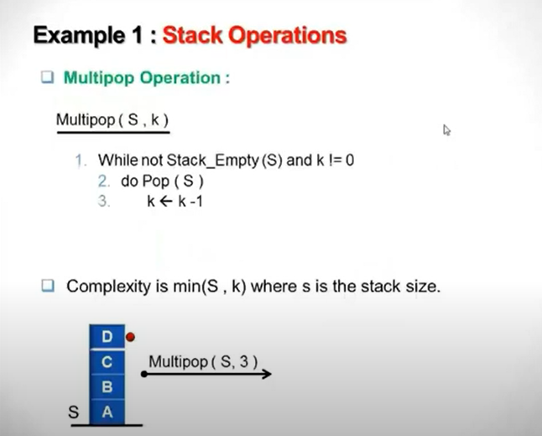

Slide 29
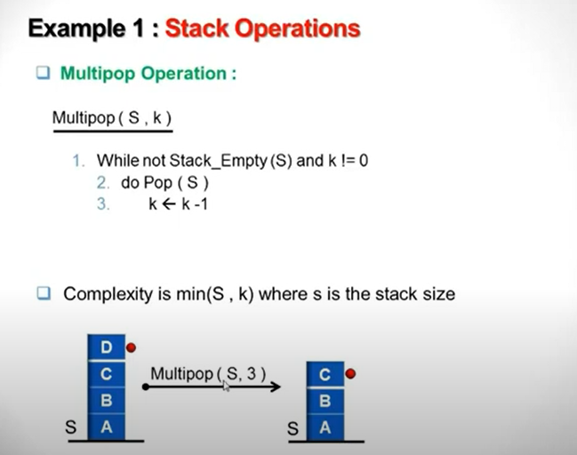

Slide 30
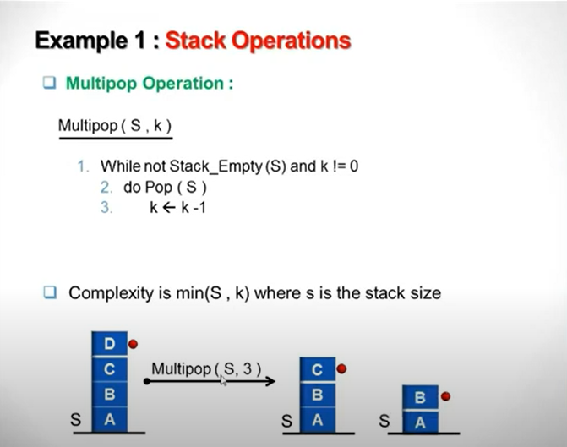

Slide 31
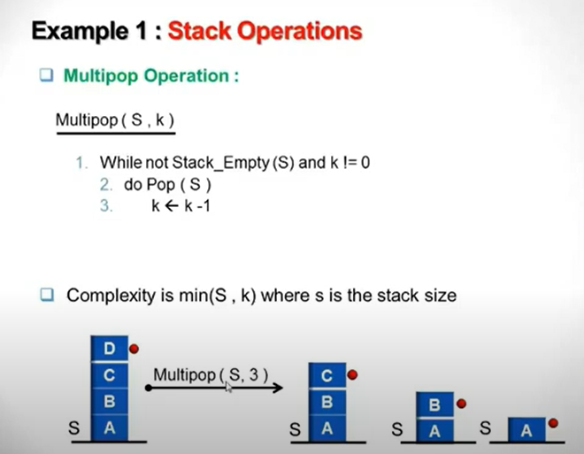

Slide 32
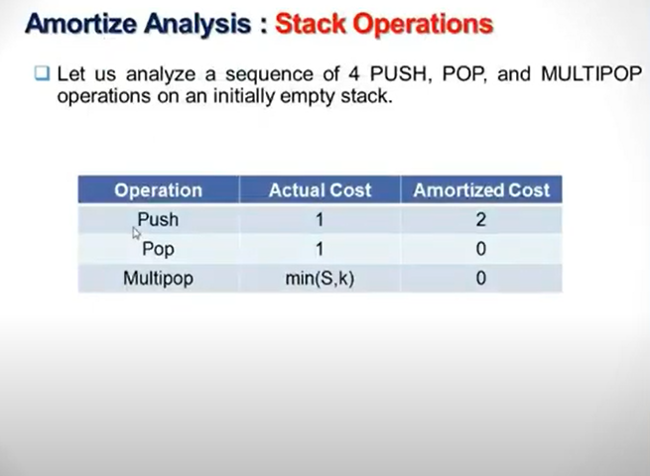

Slide 33
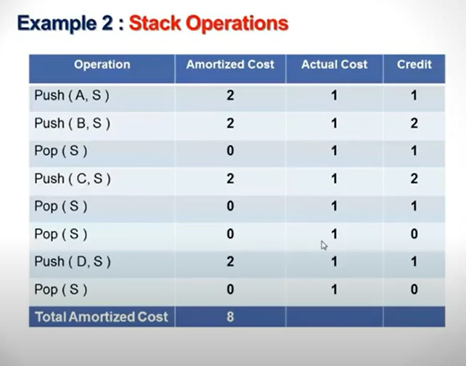

Slide 34
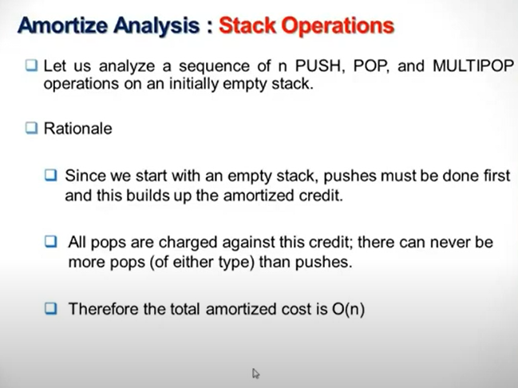

Slide 35
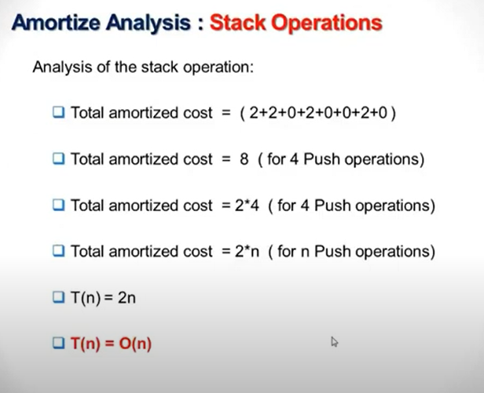

Slide 36
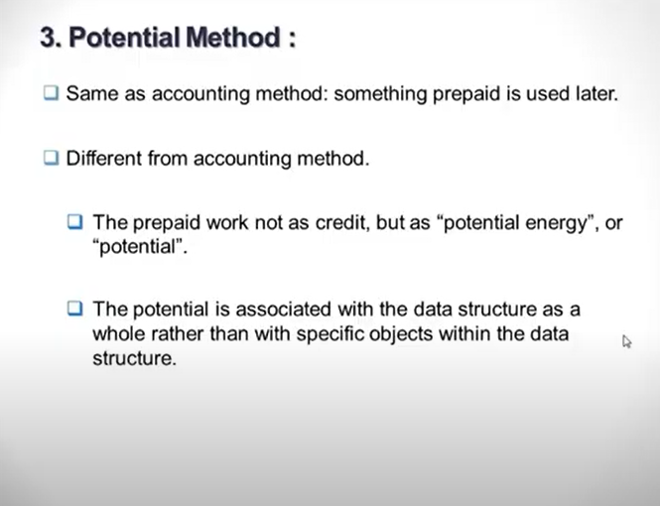

Slide 37
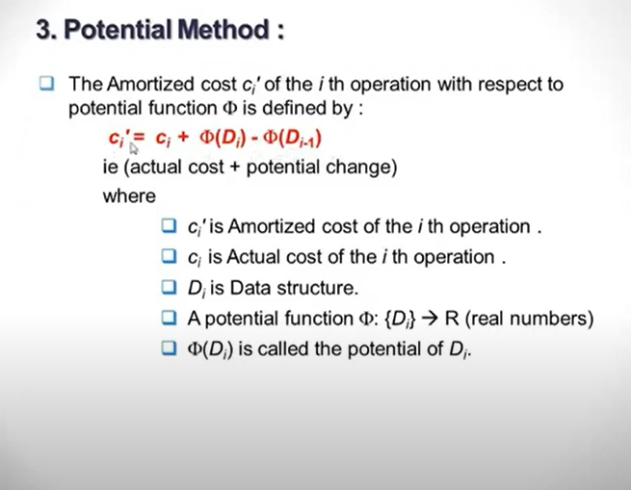

Slide 38
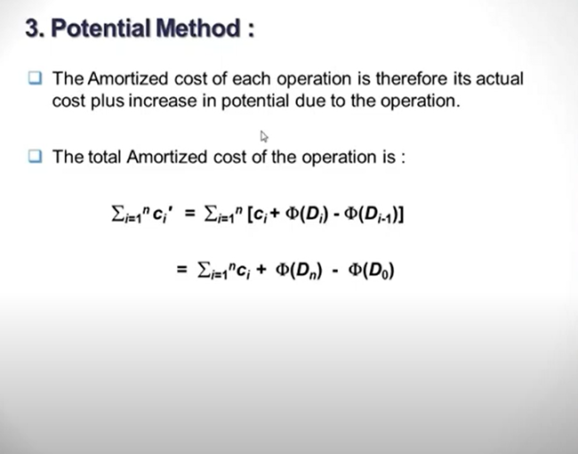

Slide 39
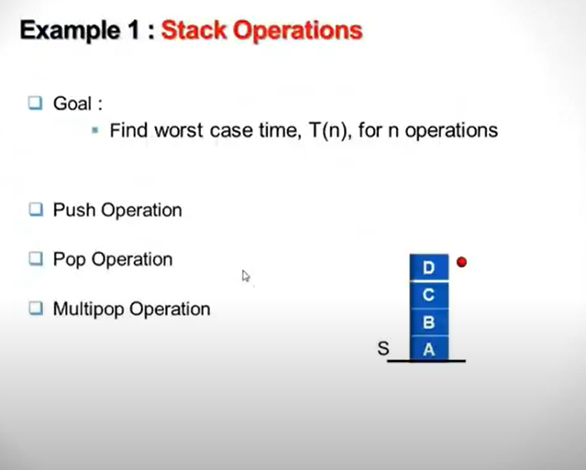

Slide 40
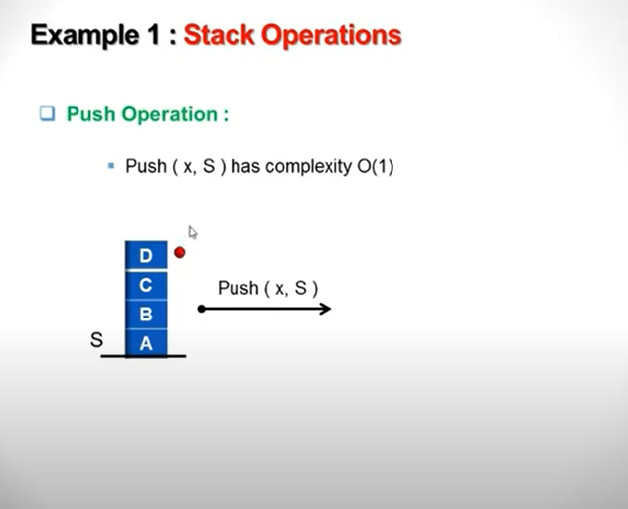

Slide 41
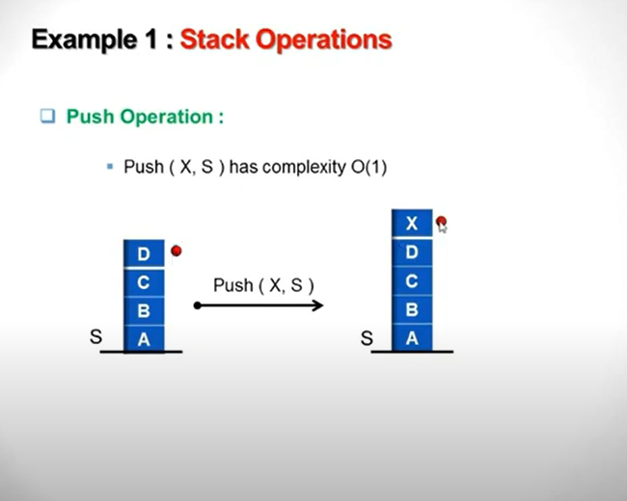

Slide 42
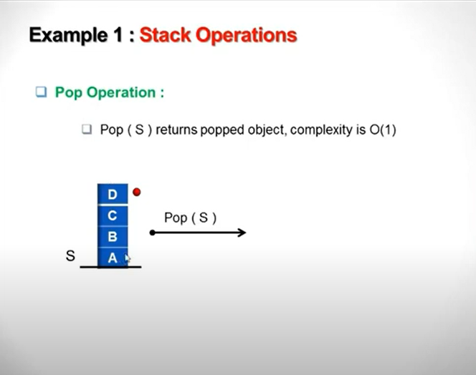

Slide 43
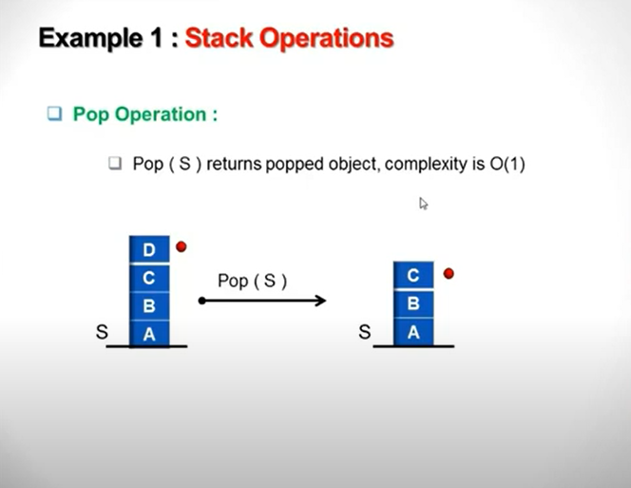

Slide 44
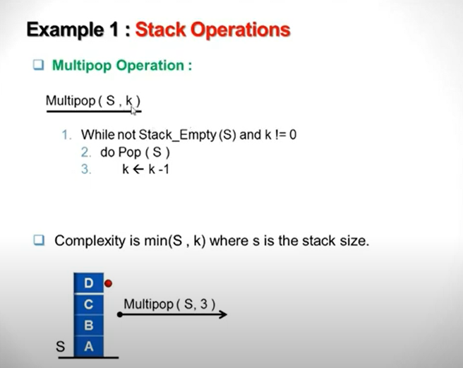

Slide 45
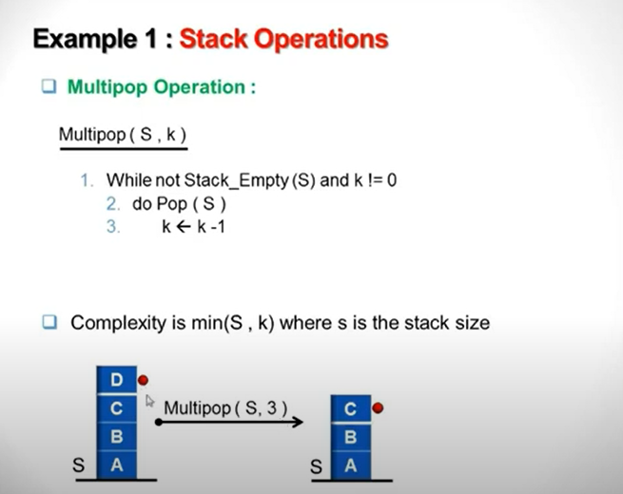

Slide 46
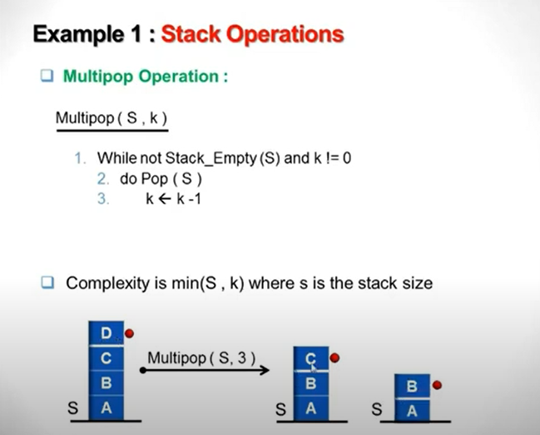

Slide 47
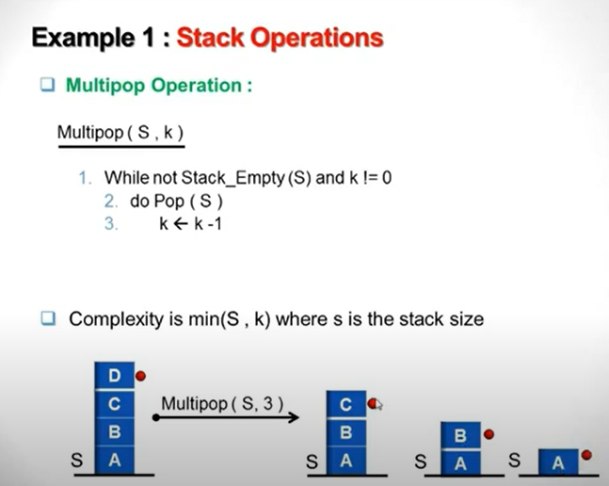

Slide 48
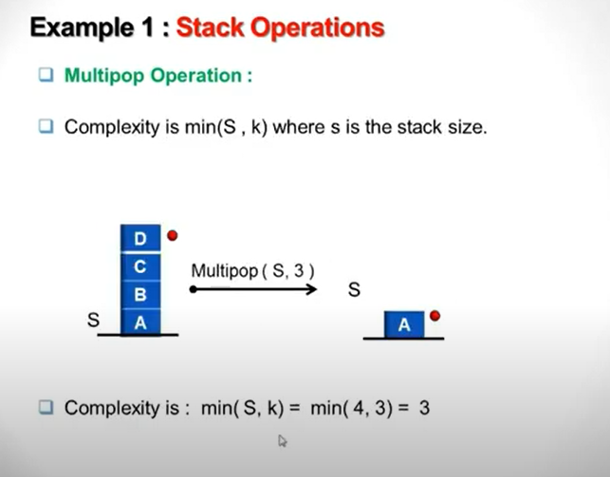

Slide 49
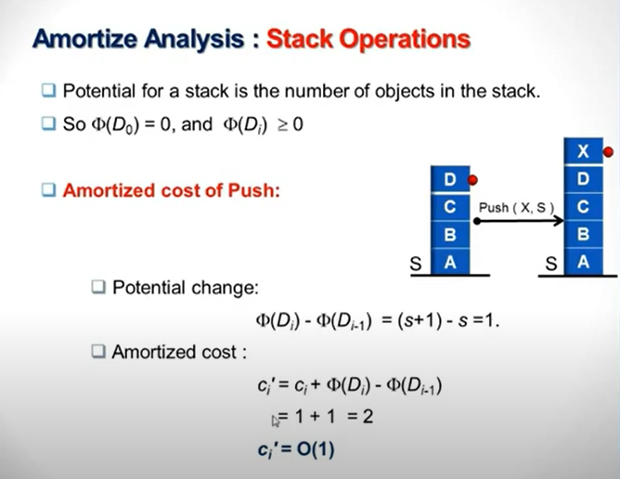

Slide 50
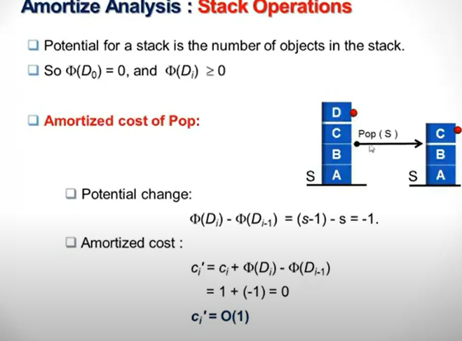

Slide 51
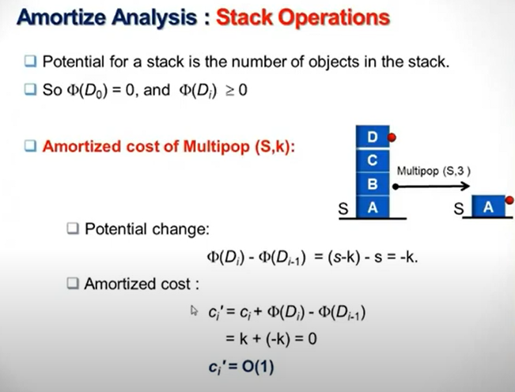

Slide 52
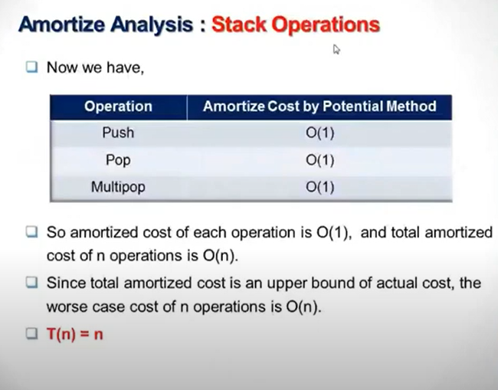

Slide 53
Randomized Algorithms

Slide 54
In General
Make random decisions in operation
Non-deterministic sequence of operations
No input reliably gives worst-case results

Slide 55
Sorting
Classic Quicksort
Can be fast - O(n log n)
Can be slow - O(n²)
Based on how good a “splitter” is chosen

Slide 56
Good Splitters
We want the set to be split into roughly even halves
Worst case when one half empty and the other has all elements
O(n log n) when both splits are larger than n/4

Slide 57
Good Splitters
So, (3/4)n - (1/4)n = n/2 are good splitters
If we choose a splitter at random we have a 50% chance of getting a good one

Slide 58
Las Vegas vs. Monte Carlo
Randomized Quicksort always returns the correct answer, making it a Las Vegas algorithm
Monte Carlo algorithms return approximate answers (Monte Carlo Pi)

Slide 59
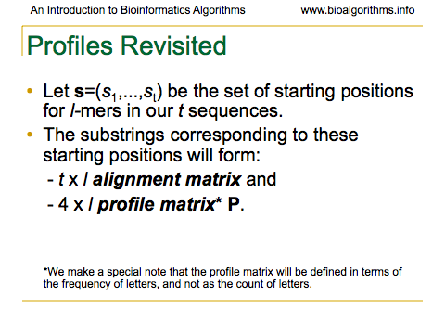

Slide 60
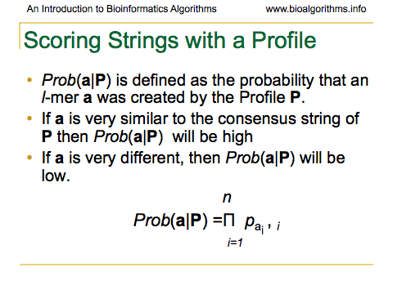

Slide 61


Slide 62


Slide 63


Slide 64


Slide 65
Segment tree and Interval Tree

Slide 66
The problem (1-D)
Given a set of segments S on the line, preprocess them to build a structure that allows efficient queries of the from:
Given a point x find all intervals containing it.
0
x

Slide 67
Segment tree
A
E
F
0
G
H
I
J
K
B
C
D
Place segment s in any node v such that s contains the segment corresponding to v but not the segment corresponding to p(v)
A
B
C
D
E
F
G
H
I
J
K

Slide 68
Segment tree (Cont)
A
E
F
0
G
H
I
J
K
B
C
D
Keep a list of segments at each node
A
B
C
D
E
F
G
H
I
J
K

Slide 69
Segment tree (analysis)
Each segment appears in at most 2 nodes per level.
➔ Space O(n log n)
To answer a query x, traverse the search path of x and report all segments in these nodes ➔ O(log n + k) time

Slide 70
Segment tree -- query
A
E
F
0
G
H
I
J
K
B
C
x
D
A
B
C
D
E
F
G
H
I
J
K

Slide 71
Dynamic segment trees
A
E
F
0
G
H
I
J
K
B
C
D
A
B
C
D
E
F
G
H
I
J
K

Slide 72
Dynamic segment trees
A
E
F
0
G
H
I
J
K
B
D
C’
C’’
A
B
C
D
E
F
G
H
I
J
K

Slide 73
Dynamic segment trees
A
E
F
0
G
H
I
J
K
B
C
D
C’
C’’
A
B
D
E
C’
C’’
F
G
H
I
J
K

Slide 74
Dynamic segment trees
A
E
F
0
G
I
J
K
B
C
D
H’
H’’
C’
C’’
A
B
D
E
C’
C’’
F
G
H
I
J
K

Slide 75
Dynamic segment trees
A
E
F
0
G
I
J
K
B
C
D
H’
H’’
C’
C’’
A
B
D
E
C’
C’’
F
G
I
J
K
H’
H’’

Slide 76
Rotations….
What about rebalancing ?
x
y
<===>
a
A
y
x
C
b
B
C
A
B
The number of intervals involved is proportional to the size of the subtree underneath x

Slide 77
Dynamic segment tree (Cont)
We need a BB(α) tree
So we get insertions and deletions in O(log n) amortized time.

Slide 78
Interval tree
A
E
F
0
G
H
I
J
K
B
C
D
Place segment s in the LCA of its endpoints
A
B
C
D
E
F
G
H
I
J
K

Slide 79
Interval tree (Cont)
A
E
F
0
G
H
I
J
K
B
C
D
In each node maintain the segments sorted by
Right endpoint
Left endpoint
In two balanced search trees
A
B
C
D
E
F
G
H
I
J
K

Slide 80
A
E
F
0
G
H
I
J
K
B
C
D
A
B
C
D
E
F
G
H
I
J
K
The space is O(n) !

Slide 81
A
B
C
D
E
F
G
H
I
J
K
To do a query at x, traverse the search path of x:
At each node traverse the right tree if you go right and the left tree if you go left
A
B
C
D
E
F
G
H
I
J
K

Slide 82
y
B
C
When you go left, traverse the left tree until you hit the first interval that does not contain the query (similarly when you go right)
Query time is O(log n + k)

Slide 83
Dynamic interval tree
A
B
C
D
E
F
G
H
I
J
K
C’
C’’
H’
H’’
A
B
C
D
E
F
G
H
I
J
K

Slide 84
Dynamic interval tree
A
B
D
E
F
G
I
J
K
C’
C’’
H’
H’’
A
B
D
E
C’
C’’
F
G
I
J
K
H’
H’’

Slide 85
Dynamic interval tree
A
B
D
E
F
G
I
J
K
C’
C’’
H’
H’’
A
B
D
E
C’
C’’
F
G
I
J
K
H’
H’’

Slide 86
Dynamic interval tree
A
B
D
E
F
G
I
J
K
C’
C’’
H’
H’’
A
B
D
E
C’
C’’
F
G
I
J
K
H’
H’’

Slide 87
Rotations….
What about rebalancing ?
x
y
<===>
A
y
x
C
B
C
A
B
The number of intervals involved is proportional to the size of the subtree underneath x

Slide 88
Dynamic interval tree (Cont)
We need a BB(α) tree
So we get insertions and deletions in O(log n) amortized time.

Slide 89
Two-dimensional Extension
Consider a set of horizontal line segments in the plane. The query object is a vertical line segments.

Slide 90
Segment tree- treating the horizontal line segments as intervals on a line
A
E
F
0
G
H
I
J
K
B
C
x
D
A
B
C
D
E
F
G
H
I
J
K

Slide 91
At each internal node u:
We keep the intervals stored at u in sorted y-order. If the x-value of the query interval q=q_{x}× [y₁:y₂] is contained in Int(u), we determine the intersecting intervals at u with query q in O(log n_{v}+k_{v}) time where n_{u} is the number of intervals stored at u and k_{u} is the number of intersecting intervals.

Slide 92
Total query time:
There are O(logn) nodes. Total query time is
O(log²n+k) time.

Slide 93
THANK YOU
For queries
Email: Rahul.e10843@cumail.in

